Slide 1
ANALYSIS ON COVID-19 GLOBAL AND INDIA DATASET
NAME: GARIMA KEHAR
REGISTRATION NO: 11902683
COURSE CODE: KM002-INT 217

Slide 2

CONTENT OF PROJECT
MOTIVE OF THIS PROJECT
INTRODUCTION
MAIN DASHBOARD
DASHBOARD 1
DASHBOARD 2
DASHBOARD 3
DASHBOARD 4
DASHBOARD 5
DASHBOARD 6
CONCLUSION

Slide 3
Motive of this project
The main motive to choose this topic is that as corona is one of the leading topic of the world. Corona has effected thousands of people life so want to check which country is mostly effected by covid-19 and similarly see which state of India is mostly effected by covid-19.
In this project I had chosen different- different datasets which includes world dataset of covid cases and vaccination status data set of world. I had also taken India’s data set of both cases and the vaccination.
My last but not the least dataset is unemployment dataset of urban and rural area of India.

Slide 4
Introduction
In this project I had created different-different dashboards to show my objectives in the summarise way. For creating the dashboard I had used different-different graphs, shapes, icons and also created the links so that without scrolling much just one click on the icon we will reached to our destination or if we want to see the objectives or data set for that also different-different links are created. .
Lets see the glimpse of my project with the help of dashboards one by one. …

Slide 5
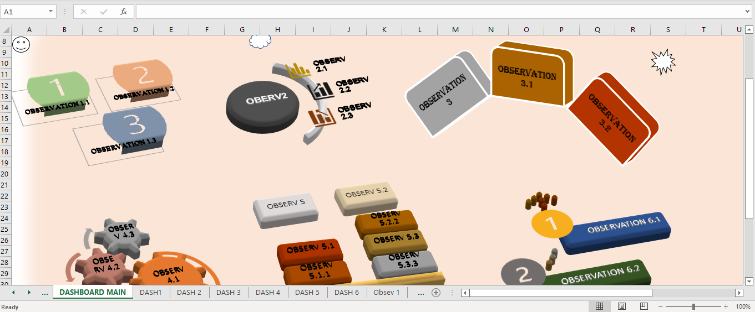
Main dashboard
This is my main dashboard. Here we can see that there are total 6 different objectives with there sub objectives. Here on click on the shapes that is mentioned above we can see their respective dashboards.

Slide 6
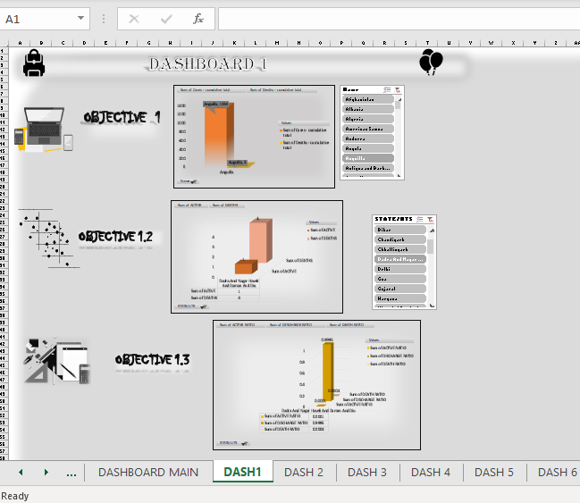
Dashboard 1
This is my first dashboard here total 3 objectives graph are present which represent my 1st objective. My 1st objective is analysis on the no of cumulative cases and cumulative death cases in the world and India . And if we click on the text we will reach to their respective objectives which are created by using pivot tables, pivot graphs, slicers etc.

Slide 7
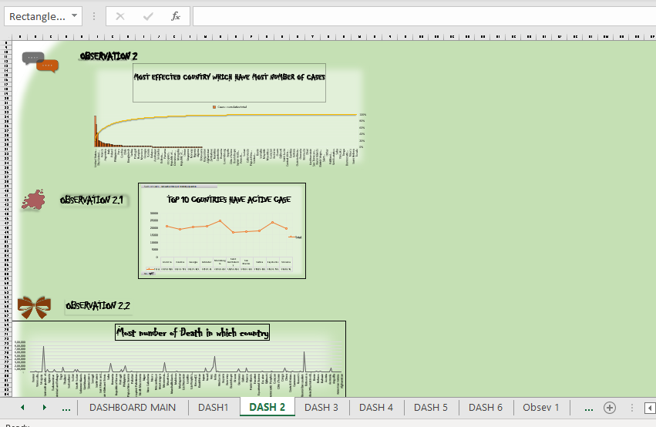
Dashboard 2
This is my second dashboard here total 4 objectives graph are present which represent my 2st objective. My 2st objective is most effected country due to active and death case .
And after the analysis the result is united state of republic is most affected country , Montenegro has most no of active case as per 10k population and Peru has most no of death cases.

Slide 8
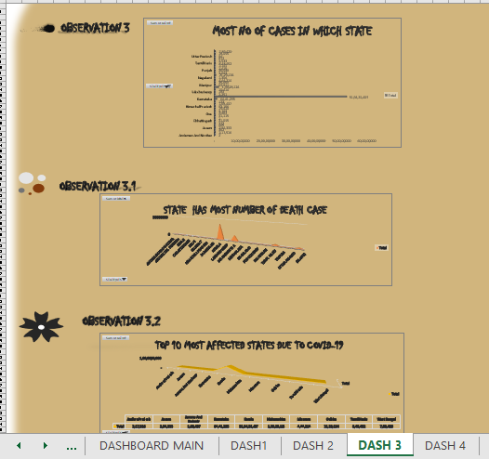
Dashboard 3
This is my third dashboard here total 3 objectives graph are present which represent my 3rd objective. My 3rd objective is most effected state due to active and death case .
And after the analysis the result is Kerela and Maharashtra is most affected state which has most no of active and death cases

Slide 9
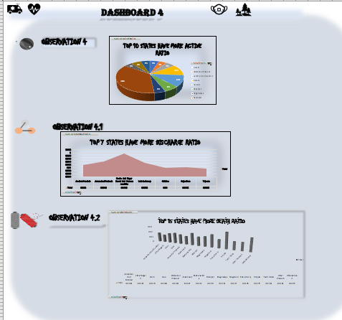
Dashboard 4
This is my fourth dashboard here total 3 objectives graph are present which represent my 4th objective. My 4th objective is active ratio vs discharge ratio vs death ratio.
And after the analysis the result is Mizoram has most no of active ratio.
Daman and Diu has most no of discharge ratio and Punjab has most no of death ratio.

Slide 10
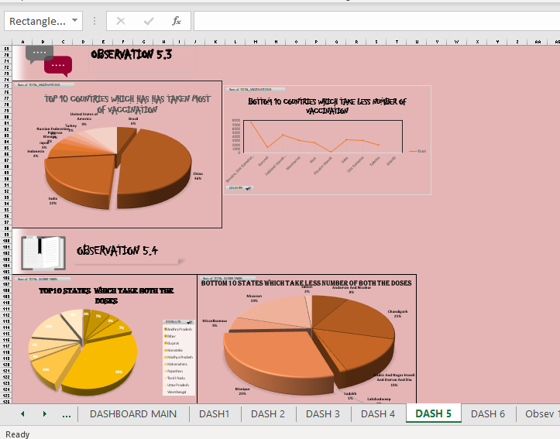
Dashboard 5
This is my fifth dashboard here total 7 objectives graph are present which represent my 5th objective. My ^{5th} objective is vaccination status country wise and India’s state wise
Here I am showing my 2 objectives only. Which show the bottom and top country and state which used most no of vaccination

Slide 11
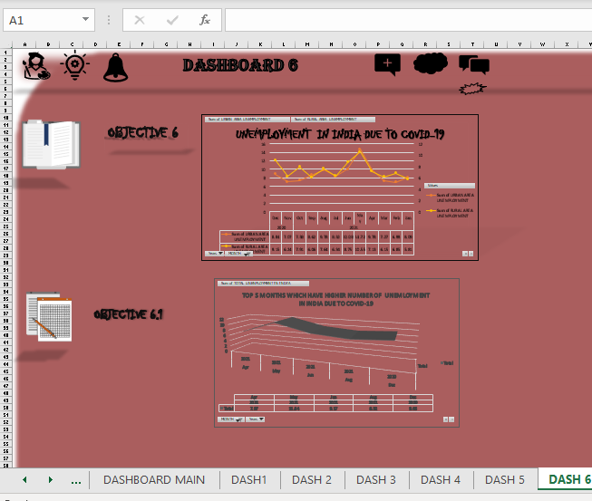
Dashboard 6
This is my last dashboard here total 2 objectives graph are present which represent my 6th objective. My 6th objective is unemployment due to covid-19 in India .
And after the analysis the result is the month of May the unemployment rate is high in India.

Slide 12
CONCLUSION
So this is end of my project here I had used pivot tables, graphs, slicers, operators, icons, links and also protected my datasets so nobody can change my data . And analysis a lot of things that are
Which Country is most affected by covid.
How many states has taken the both the vaccination doses .
At which month unemployment is most in India.
and more analysis had been done.
There are total 22 objectives, 7 dashboard and many graphs.
Learnt a lot about the excel that which the help of 1 sheet we can create a lot more things

Slide 13
THANK YOU

